Slide 1
Versão de: CS 152 Computer Architecture and Engineering Lecture 16: Vector Computers
Krste Asanovic
Electrical Engineering and Computer Sciences
University of California, Berkeley
http://www.eecs.berkeley.edu/~krste
http://inst.cs.berkeley.edu/~cs152

Slide 2
Supercomputers
Definition of a supercomputer:
Fastest machine in world at given task
A device to turn a compute-bound problem into an I/O bound problem
Any machine costing $30M+
Any machine designed by Seymour Cray
CDC6600 (Cray, 1964) regarded as first supercomputer

Slide 3
Supercomputer Applications
Typical application areas
Military research (nuclear weapons, cryptography)
Scientific research
Weather forecasting
Oil exploration
Industrial design (car crash simulation)
Bioinformatics
Cryptography
All involve huge computations on large data sets
In 70s-80s, Supercomputer ≡ Vector Machine

Slide 4
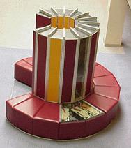
Vector Supercomputers
Epitomized by Cray-1, 1976:
Scalar Unit
Load/Store Architecture
Vector Extension
Vector Registers
Vector Instructions
Implementation
Hardwired Control
Highly Pipelined Functional Units
Interleaved Memory System
No Data Caches
No Virtual Memory

Slide 5
Cray-1 (1976)
V0
V_{i}
V. Mask
V1
V_{j}
64 Element Vector Registers
V2
V. Length
V3
V_{k}
Single Port
Memory
16 banks of 64-bit words
+
8-bit SECDED
80MW/sec data load/store
320MW/sec instruction
buffer refill
V4
V5
V6
V7
FP Add
S0
S_{j}
FP Mul
( (A_{h}) + j k m )
S1
S2
S_{k}
FP Recip
64
T Regs
S_{i}
S3
(A₀)
S4
S_{i}
Int Add
T_{jk}
S5
S6
Int Logic
S7
Int Shift
( (A_{h}) + j k m )
A0
Pop Cnt
A1
A_{i}
A2
A_{j}
(A₀)
64
B Regs
A3
A_{k}
Addr Add
B_{jk}
A4
A5
A_{i}
Addr Mul
A6
A7
64-bitx16
NIP
CIP
4 Instruction Buffers
LIP
memory bank cycle 50 ns processor cycle 12.5 ns (80MHz)

Slide 6
Limits of Static Scheduling
Unpredictable branches
Variable memory latency (unpredictable cache misses)
Code size explosion
Compiler complexity
Despite several attempts, VLIW has failed in general-purpose computing arena.
Successful in GPU and embedded DSP market.

Slide 7
Vector Programming Model
Scalar Registers
Vector Registers
r15
v15
r0
v0
[0]
[1]
[2]
[VLRMAX-1]
Vector Length Register
VLR
v1
Vector Arithmetic Instructions
ADDV v3, v1, v2
v2
+
+
+
+
+
+
v3
[0]
[1]
[VLR-1]
Vector Load and Store Instructions
LV v1, r1, r2
Vector Register
v1
Memory
Base, r1
Stride, r2

Slide 8
Vector Code Example
# C code
for (i=0; i<64; i++)
C[i] = A[i] + B[i];
# Scalar Code
LI R4, 64
loop:
L.D F0, 0(R1)
L.D F2, 0(R2)
ADD.D F4, F2, F0
S.D F4, 0(R3)
DADDIU R1, 8
DADDIU R2, 8
DADDIU R3, 8
DSUBIU R4, 1
BNEZ R4, loop
# Vector Code
LI VLR, 64
LV V1, R1
LV V2, R2
ADDV.D V3, V1, V2
SV V3, R3
Todas as instruções executam apenas uma vez
De loop: para baixo, todas as instruções executam 64 vezes

Slide 9
Vector Instruction Set Advantages
Compact
one short instruction encodes N operations
Expressive, tells hardware that these N operations:
are independent
use the same functional unit
access disjoint registers
access registers in same pattern as previous operations
access a contiguous block of memory (unit-stride load/store)
access memory in a known pattern (strided load/store)
Scalable
can run same code on more parallel pipelines (lanes)

Slide 10
Vector Arithmetic Execution
Use deep pipeline (=> fast clock) to execute element operations
Simplifies control of deep pipeline because elements in vector are independent (=> no hazards!)
V1
V2
V3
Six stage multiply pipeline
V3 <- V1 * V2

Slide 11
Vector Instruction Execution
ADDV C,A,B
Execution using one pipelined functional unit
Execution using four pipelined functional units
A[6]
B[6]
A[24]
B[24]
A[25]
B[25]
A[26]
B[26]
A[27]
B[27]
A[5]
B[5]
A[20]
B[20]
A[21]
B[21]
A[22]
B[22]
A[23]
B[23]
A[4]
B[4]
A[16]
B[16]
A[17]
B[17]
A[18]
B[18]
A[19]
B[19]
A[3]
B[3]
A[12]
B[12]
A[13]
B[13]
A[14]
B[14]
A[15]
B[15]
C[2]
C[8]
C[9]
C[10]
C[11]
C[1]
C[4]
C[5]
C[6]
C[7]
C[0]
C[0]
C[1]
C[2]
C[3]

Slide 12
Vector Memory System
Cray-1, 16 banks, 4 cycle bank busy time, 12 cycle latency
Bank busy time: Time before bank ready to accept next request
Base
Stride
Vector Registers
Address Generator
0
1
2
3
4
5
6
7
8
9
A
B
C
D
E
F
Memory Banks

Slide 13
Vector Unit Structure
Functional Unit
Vector
Registers
Elements 0, 4, 8, …
Elements 1, 5, 9, …
Elements 2, 6, 10, …
Elements 3, 7, 11, …
Lane
Memory Subsystem

Slide 14
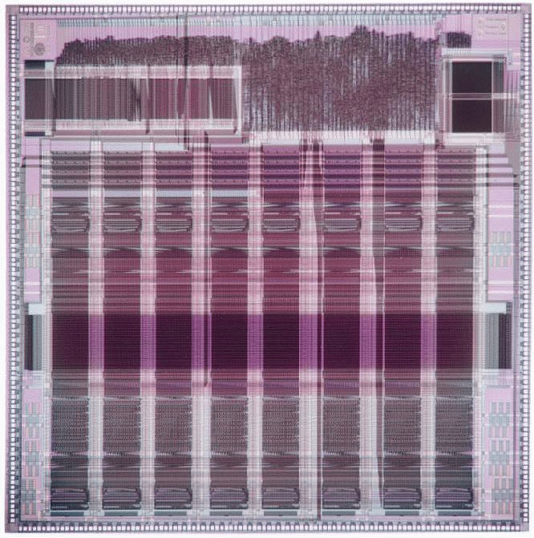
T0 Vector Microprocessor (UCB/ICSI, 1995)
Vector register elements striped over lanes
Lane
[24]
[25]
[26]
[27]
[28]
[29]
[30]
[31]
[16]
[17]
[18]
[19]
[20]
[21]
[22]
[23]
[8]
[9]
[10]
[11]
[12]
[13]
[14]
[15]
[0]
[1]
[2]
[3]
[4]
[5]
[6]
[7]

Slide 15
Vector Instruction Parallelism
Can overlap execution of multiple vector instructions
example machine has 32 elements per vector register and 8 lanes
Load Unit
Multiply Unit
Add Unit
load
mul
add
time
load
mul
add
Instruction issue
Complete 24 operations/cycle while issuing 1 short instruction/cycle

Slide 16
Vector Chaining
Vector version of register bypassing
introduced with Cray-1
V1
V2
V3
V4
V5
LV v1
MULV v3,v1,v2
ADDV v5, v3, v4
Chain
Chain
Load Unit
Mult.
Add
Memory

Slide 17
Vector Chaining Advantage
Without chaining, must wait for last element of result to be written before starting dependent instruction
Load
Mul
Time
Add
With chaining, can start dependent instruction as soon as first result appears
Load
Mul
Add

Slide 18
Vector Startup
Two components of vector startup penalty
functional unit latency (time through pipeline)
dead time or recovery time (time before another vector instruction can start down pipeline)
Functional Unit Latency
R
X
X
X
W
R
X
X
X
W
First Vector Instruction
R
X
X
X
W
R
X
X
X
W
R
X
X
X
W
Dead Time
R
X
X
X
W
R
X
X
X
W
R
X
X
X
W
Dead Time
R
X
X
X
W
Second Vector Instruction
R
X
X
X
W

Slide 19
Dead Time and Short Vectors
No dead time
4 cycles dead time
T0, Eight lanes
No dead time
100% efficiency with 8 element vectors
64 cycles active
Cray C90, Two lanes
4 cycle dead time
Maximum efficiency 94% with 128 element vectors

Slide 20
Vector Memory-Memory versus Vector Register Machines
Vector memory-memory instructions hold all vector operands in main memory
The first vector machines, CDC Star-100 (‘73) and TI ASC (‘71), were memory-memory machines
Cray-1 (’76) was first vector register machine
Vector Memory-Memory Code
Example Source Code
ADDV C, A, B
SUBV D, A, B
for (i=0; i<N; i++)
{
C[i] = A[i] + B[i];
D[i] = A[i] - B[i];
}
Vector Register Code
LV V1, A
LV V2, B
ADDV V3, V1, V2
SV V3, C
SUBV V4, V1, V2
SV V4, D

Slide 21
Vector Memory-Memory vs. Vector Register Machines
Vector memory-memory architectures (VMMA) require greater main memory bandwidth, why?
All operands must be read in and out of memory
VMMAs make if difficult to overlap execution of multiple vector operations, why?
Must check dependencies on memory addresses
VMMAs incur greater startup latency
Scalar code was faster on CDC Star-100 for vectors < 100 elements
For Cray-1, vector/scalar breakeven point was around 2 elements
Apart from CDC follow-ons (Cyber-205, ETA-10) all major vector machines since Cray-1 have had vector register architectures
(we ignore vector memory-memory from now on)

Slide 22
Acknowledgements
These slides contain material developed and copyright by:
Arvind (MIT)
Krste Asanovic (MIT/UCB)
Joel Emer (Intel/MIT)
James Hoe (CMU)
John Kubiatowicz (UCB)
David Patterson (UCB)
MIT material derived from course 6.823
UCB material derived from course CS252

